Slide 1
RESEARCH PROBLEM
The first step in any research is to identify and define a problem or issue that requires a search for information in order to solve it.
  A research problem is a perceived difficulty or uneasy situation (in marketing, ICT, or other field).
  This difficulty or uneasy situation can be theoretical, methodological, or practical.
Thus, identifying and defining a research answers the question “why should we do the research?”
The importance of defining the problem well is reflected in following says “a problem well defined is half solved” (Kotler, 1986: P.197).

Slide 2
Sources of research problems
  Personal experience: implementers of decisions and activities eg., managers and users, can personally feel problems. These problems may call for research to solve.
  Industry experts interviews: while interviewing industry experts over a certain topic, the experts can point to existence of a problem.
  Media: documentaries done on various issues, live coverage, and panel discussions in media cover various social problems.

Slide 3
  Previous research publications: previous research work, published as books and journal articles often point to existing challenges or problems that need research in their respective topics.
  Government (official) records: government records such as court decisions, and reports on surveys and census contain secondary data that are important sources of problems. By reading these sources one can be able to detect problems.
  Policy documents: governments form policies to guide intervention for pressing problems. By reading policies, one can identify problems.

Slide 4
Defining a research problem
Defining a research problem clearly involves clarifying on several aspects of the problem.
These aspects, in academic research, include;
  detailing background of the problem,
  stating the problem,
  articulating research objectives,
  stating assumptions underlying the problem which will have to be proved or questions that the research should answer
  explaining the significance of the study, and
  establishing the scope and limitations of the study.

Slide 5
Background to the problem
  It is a detailed account to the origin, status, and knowledge gap on the problem.
  This cover paragraphs which details involve:-
  Origin and rationale of practice in relation to the topic of interest
  Problem about practice in relation to the topic of interest
  Knowledge from prior research about resolving problem of interest
  Deficiency in knowledge from prior research on how to solve the problem
  Proposal of the study to be conducted

Slide 6
In order for the researcher to identify a problem, s/he must;
  have expectations,
  feed back on expectations, and
  compare expectations and feed back.
Where the feedback falls short enough, there is a gap/problem.
In addition, the researcher should
  know where and when the gap occurred.
Short of these, the researcher will fail state the problem well.

Slide 7
Example
Causes of Customers’ Fraud in Mobile Banking Services in Tanzania.
1. 1 Background to the problem
Telecommunication has changed banking practice, introducing mobile phone enabled banking services. Customers use a mobile to deposit, withdraw, send, and receive money from a bank account (Barnes & Corbitt, 2003). In Tanzania, mobile banking was introduced in 2008 when E-fulusi company in cooperation with FBME Bank Ltd came up with Mobipawa mobile banking plat-form that enabled persons to transfer funds and pay various transactions using mobile phone(Mwinyimvua et al., 2015). Since then, banks, in collaboration with mobile companies, have adopted widely mobile banking as an alternative financial service delivery chanel. As a result, mobile phone services due to their wide spread, have quickened, eased, and increased access to banking services in less cost, time, and convenience (Shaban et al. 2014).

Slide 8
Although mobile banking is important, its practice is not free from problems. One of the problems of mobile phone-enabled banking services is fraud. According to Magari (2020), about 65% of interviewed customer who use mobile banking have been affected by fraud where their money gets stolen. This fraud reduces the trust among customers in the banking and associated mobile services. Thus, customers can stop using banking and mobile money services and resort to tradition means such as saving money in their homes which is more risker to theft and other risks such as fire outbreak (Nyongo, 219). Hence, research is needed to know the causes of fraud and how to mitigate it.
Existing research on the causes of fraud has identified several factors. The factors include lack of awareness among customers about theft, unfaithful employees, and poor password that customers use for their mobile banking service (Ligi, 2015; Nani, 2017). Also, sharing of banking particulars among loved ones add to the risk of fraud (Maembe, 2016).

Slide 9
While prior research has provided valuable knowledge about the causes of fraud in mobile banking services, it focused on the customer being victims of fraud. However, Mawe (2018) identified those who commit fraud include banks and mobile networks company employees, customers, and professional in ICT without employment. Therefore customers are also among those who commit mobile banking related fraud. Thus, the present study seeks to understand the causes of customer led fraud in mobile banking services in Tanzania.

Slide 10
Statement of the problem
This is the specification of the perceived or experienced difficulty, or unease in a very clear and brief form.
In a nutshell the statement of the problem may consist two paragraphs, summarizing:-
  Rationale for practice, and its difficulty in relation to the phenomena of interest
  Knowledge from prior research, and its deficiency on relation to how to solve the difficult about the problem of interest, as well as proposal of the study to be conducted

Slide 11
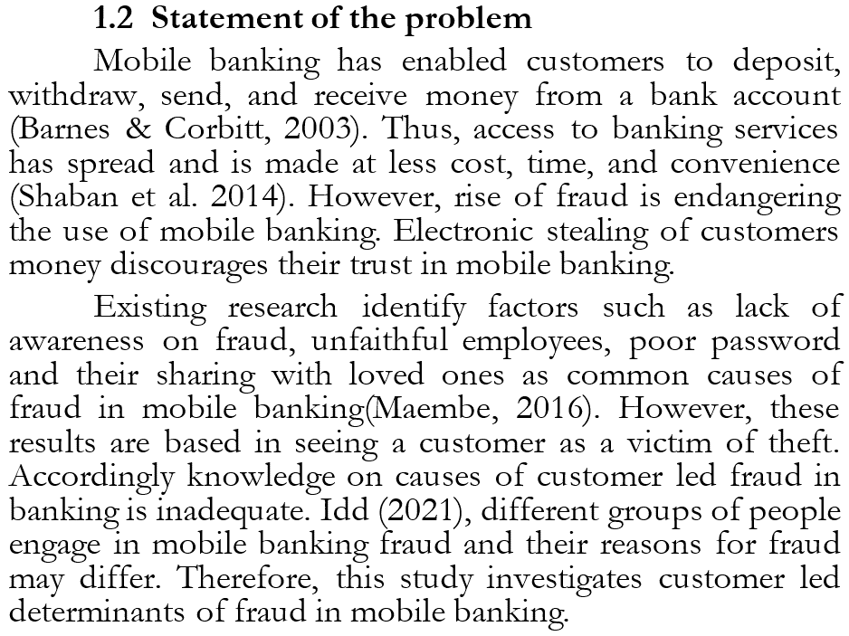

Slide 12
Research objectives
This is the specification of what the research intends to obtain in the end. in academic research tradition research objectives are divided into two groups
General research objective
  This is a broad objective that a research wishes to attain. It can not be achieved until broken down.
  Usually the general objective reflects the overall title of the research. It uses broad action verbs such as investigate, evaluate, assess etc.

Slide 13
Specific objectives
  These are more clearer, less ambiguous statements about what the research intends to achieve.
  They break the general objective into more specific statement of what the research intend to realize.
  Therefore the specific objectives should not go beyond the general objective.
  Specific objective use more measurable action verbs such as identify, determine, etc.

Slide 14
  Example of objectives
  1.3 Research objectives
  1.3.1 Research objective
  To investigate the causes of customer led mobile banking fraud in Mbeya city in Tanzania
  1.3.1 Specific research objectives
  To identify the social causes of customer led mobile banking fraud in Mbeya city in Tanzania.
  To identify personal causes of customer led mobile banking fraud in Mbeya city in Tanzania.

Slide 15
Research questions
These are queries to be answered by the information gathered in order to achieve the research objectives.
The questions should be related to the objectives to add specificity on the problem and scope of the study.
Examples of research questions
  1.4 Research questions
  1.4.1 General research question
  What are the causes of customer led mobile banking fraud in Mbeya city in Tanzania
  1.4.2 Specific research questions
  What are the social causes of customer led mobile banking fraud in Mbeya city in Tanzania?
  What are the personal causes of customer led mobile banking fraud in Mbeya city in Tanzania?

Slide 16
Scope and significance of the study
Scope of the study is concerned with stating the boundaries/limits of the study.
    Avoid personal limitations such as funds. Focus on limits due to the way the study is designed e.g. coverage of topics, area, and theories.
The significance of the study aims at stating the benefits of doing the study.
    Express how the study will help business stakeholders e.g., trainers, policy makers, researchers, and business managers.

Slide 17
  Example of objectives
  1.5 Scope and significance of the study
  1.5.1 Scope of the study
  This study is not an all encompassing, it focus will be bounded as follows:-
  First, this study will focus on factors that determine why bank customers commit mobile banking fraud. Other parties involved in committing mobile banking fraud such as bank employees will not be considered because they have been studied in prior studies.
  Second, this study will be confined to studying mobile banking fraud committed by customers in Mbeya city only. Frauds committed by customer other places of Tanzania and the world at large will not be covered.

Slide 18
  1.5.2 Significance of the study
  This study is expected to benefit different stakeholders as follows:-
  First, understanding the causes of customer’s fraud in mobile banking is important for bank managers. Given the understanding, the managers will be able to design appropriate mitigations.
  Second, the results from this study will be beneficial to trainers. Courses on banking that are designed to help trainees understand security issues in banking will benefit knowing the social and personal factors as to why bank customers commit sim banking fraud. These factors are not well established in literature

Slide 19
Discussion Questions
What is a research problem?
Outline the main components of a research problem
Identify any two research problems and state where you found them
Write the statement of the problem for one of the problem you identified in question 3
Explain the significance of studying such the problem you have stated in question

Slide 20
ASSIGNMENT
No. of Participants: 5 participants per group
Marks allocated: 10 Marks
Date of submission: 29th April 2024
Question
Read at least five (5) research articles/papers and use them to write a “statement of the problem” concerning any area/topic of interest in your field of study. At the top of your statement of the problem write the suggested topic for the study about your problem and at the bottom of your problem, provide, as a reference, a list of the papers you studied to identify the problem.

